Slide 1
Leetcode 316
123463

Slide 2
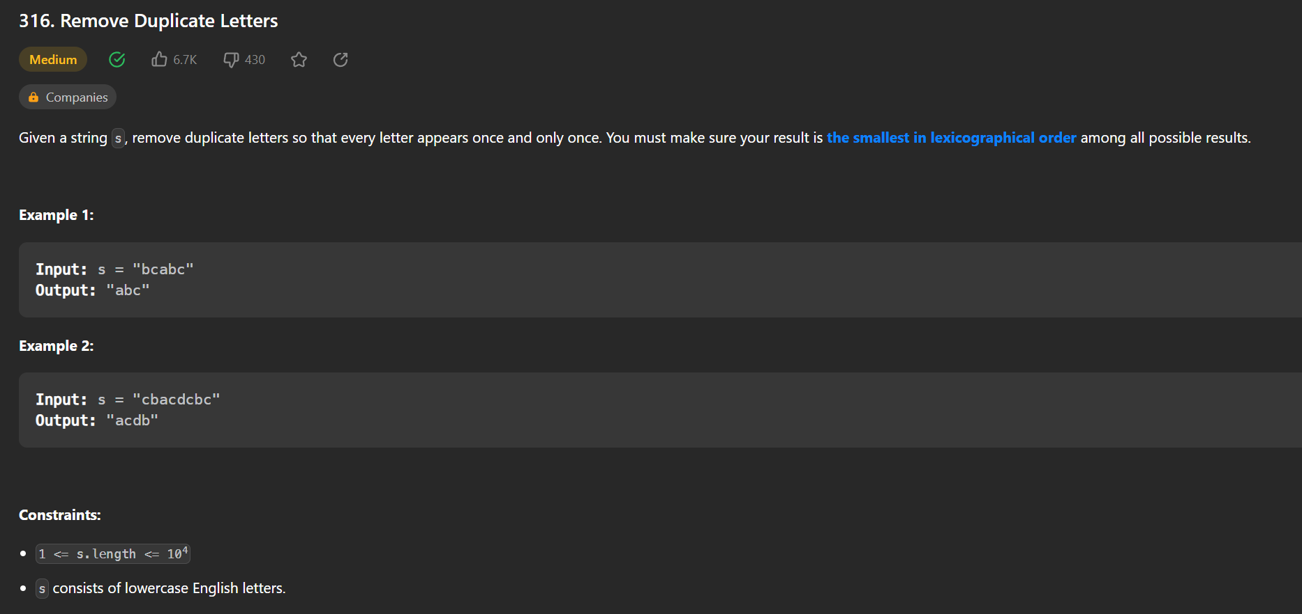

Slide 3
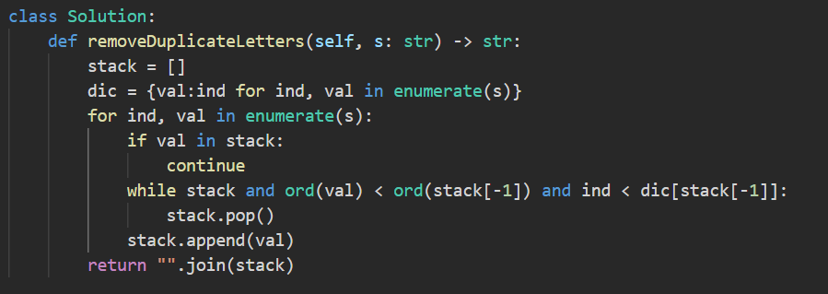

Slide 5

s = “cbacdcbc”
acdb
b
d
c
b
a
c
d
c
b
c
c
c
b
a

